Slide 1

“TaaS – Translation as a Service”
Guided:
Prof. Wasdeo Rahane
Group No. 5
Team Members:
Akhil A Balraj Upadhayay Ojas Bhat
Abhang Tiwade Pralhad Yadhav
NBN Sinhgad TECHNICAL INSTITUTE CAMPUS, PUNE-41

Slide 2
Introduction
Language and unambiguous communication plays a critical role in todays industry. The communication between employees need to be clear and unambiguous, for achieving better results.
Few of the top languages used globally are English, Mandarin, Arabic, Spanish, Russian, etc.
To achieve collaboration and better results in company an automated translator system can play a crucial role.
There are various tech-giants working on this domain, but none have provided a single solution model.

Slide 3
Problem Statement
“Neural Machine Translator based language translation system capable of providing real time translation.”

Slide 4
Hardware and Software requirements
Hardware
Processor: Any CPU with AVX(Advance Vector Extensions) instruction set, after 2011.
GPU: NVIDIA GPU with CUDA-enabled GPU cards. 8GB for optimal performance.
RAM: Recommended 16 GB.
Software
OS: Windows 10/11 or Linux derivatives
GPU Drivers: NVIDIA Drivers
Libraries: TensorFlow, Keras, Flask, Pandas.

Slide 5
Existing Models for Translator
There are primarily four models developed so far:
Rule Based Machine Translation
Statistical Machine Translation
Hybrid Machine Translation
Neural Machine Translation

Slide 6
Comparison of Machine Translation Models
Model Name | Rule Based | Statistical | Hybrid | Neural machine translation
Methodology | Complicated rules defined by Linguistics. | Probabilistic and statistical based rules instead of grammar. | Combination of two translational models | AI based learning, for the neural networks. Sequence to Sequence model.
Efficiency | Can process simple representation of words. | Machine translation accurate, only require large dataset. | Overcome shortcomings faced in each model with help of others. | State-of-the-art translation system used by major tech-giants.
Drawback | Manual definition of the dictionary is required. | Huge amount of data set is required. | Shortcoming of the different models can cause issue. | High resource for training of the model.

Slide 7
Why use NMT?
It is the current state-of-the-art model used by all the tech-giants.
Provides high accuracy of translated data.
Uses LSTM or GRU for sequential processing of the input data to the desired language.
Further developments:
i. Attention Mechanism
ii. Transformer Mechanism

Slide 8
Literature Survey
Sr No. | Title and Authors | Advantages | Limitation | Methodology | Results

Slide 9
Literature Survey
Sr No. | Title and Authors | Advantages | Limitation | Methodology | Results

Slide 10
Literature Survey
Sr No. | Title and Authors | Advantages | Limitation | Methodology | Results

Slide 11
Objectives and Goals
Objective:
Real time translation of the language to the desired language.
Model Objectives:
1. Designing of UI for capturing and transmission of data.
2. Development of the speech to text, translation, and text-to-speech system.
3. API development for interaction with the server.
4. Transmission of the translated audio reduced latency for real-time interaction.
Goal:
Development of a NMT translator system for multilingual translation.

Slide 12
Motivation and Scope
We aim to design a system providing the real time translation during meetings to mitigate the linguistic barrier between the employees.
The current approach would be optimized by integration of the various models to a single system capable of delivering the desired results.
Scope:
The project reside in the domain of Deep Learning, and machine translation system capable of translation of data from one format to another like audio to text, language translation, etc.
The model interacts with the application through APIs to deliver the results.

Slide 13
Existing System
The issues with the existing system are:
Single model for the problem isn’t available.
The integration of various model introduces latency issues among the existing models.
The existing models are generic.

Slide 14
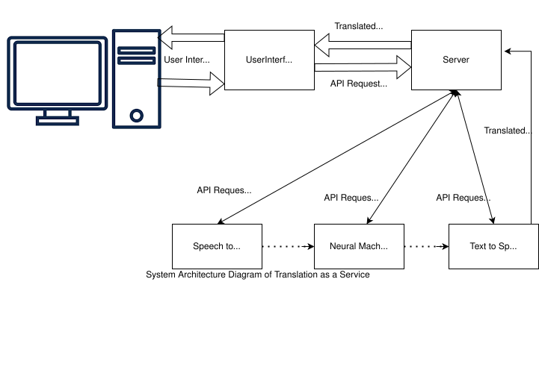
System Architecture

Slide 15
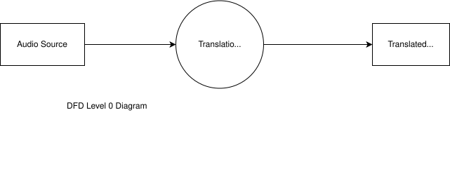
DFD Level 0

Slide 16
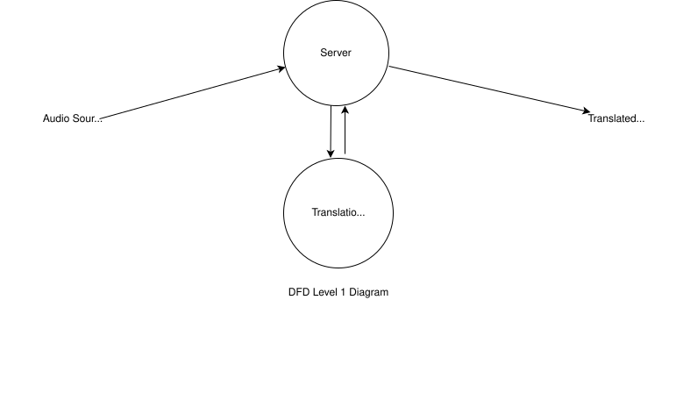
DFD Level 1

Slide 17
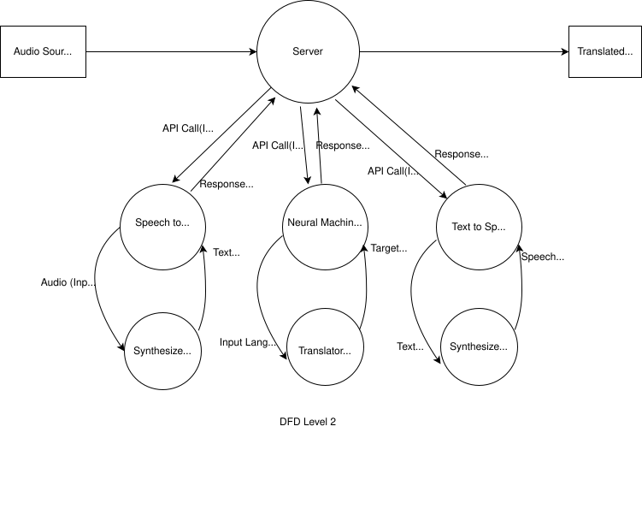
DFD Level 2

Slide 18
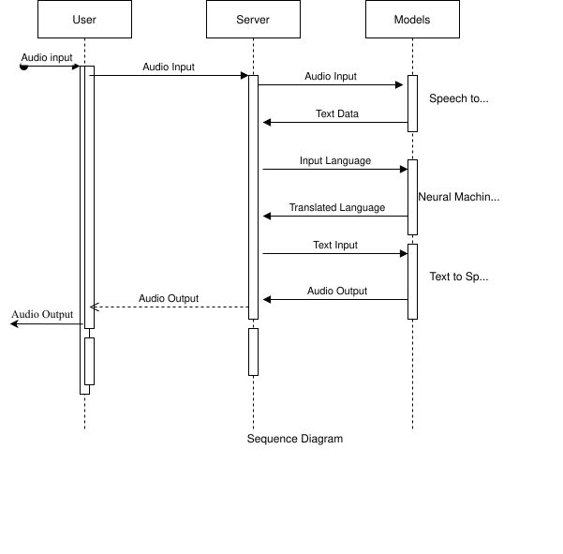
Sequence Diagram

Slide 19
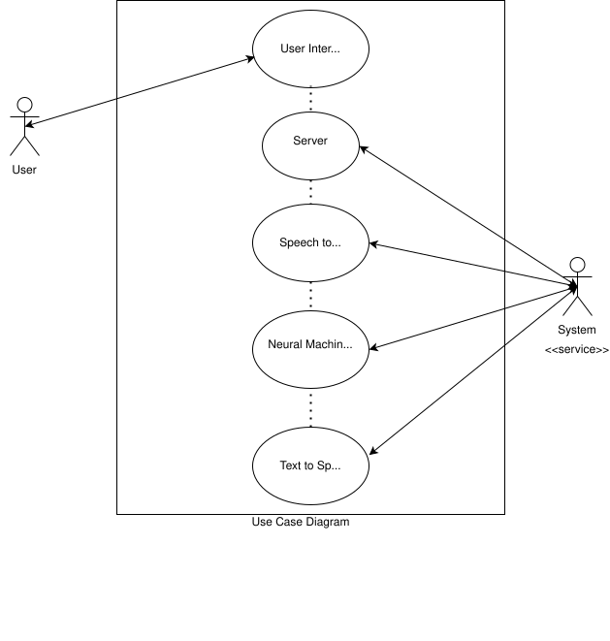
User Case Diagram

Slide 20
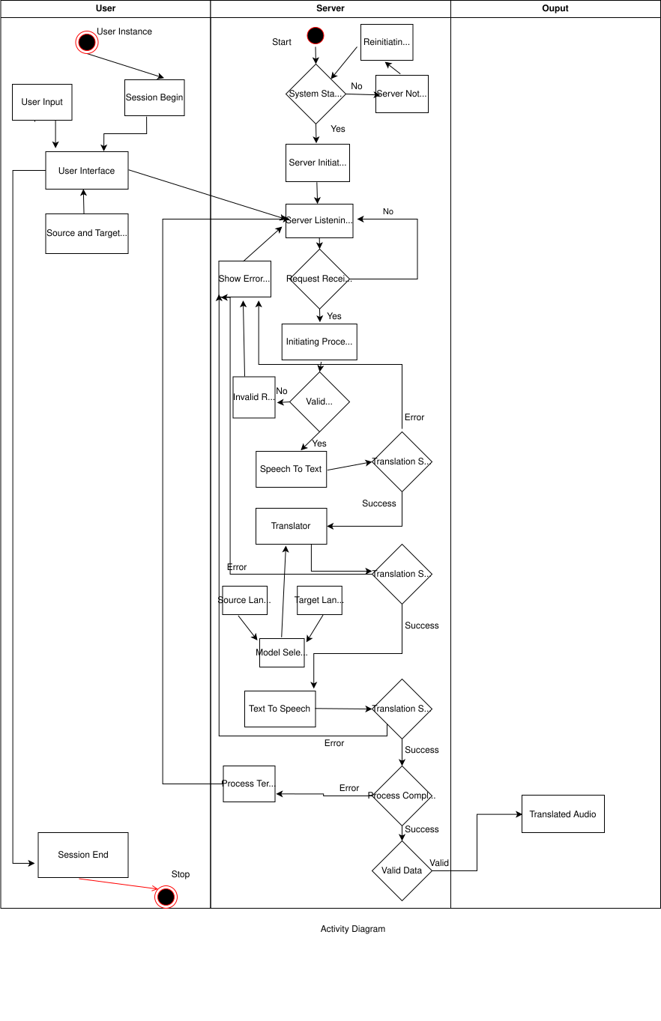
Activity Diagram

Slide 21
Activity Diagram

Slide 23
Conclusion
After study on different translation machines for language translation, we come to the conclusion that most appropriate model for development of the translational model is NMT.
NMT is capable of providing high accuracy translation service to the user.
It is resource insensitive, but it provides state-of-the-art translation services. Thus, is used by tech-giants and is being proposed to be developed through this project.

Slide 24
References
M. Akter, M. Shahidur Rahman, M. Zafar Iqbal and M. Reza Selim, "A Review of Statistical and Neural Network Based Hybrid Machine Translators," 2018 International Conference on Bangla Speech and Language Processing (ICBSLP), 2018, pp. 1-6, doi: 10.1109/ICBSLP.2018.8554792.
S. Nakamura et al., "The ATR Multilingual Speech-to-Speech Translation System," in IEEE Transactions on Audio, Speech, and Language Processing, vol. 14, no. 2, pp. 365-376, March 2006, doi: 10.1109/TSA.2005.860774.
S. P. Singh, H. Darbari, A. Kumar, S. Jain and A. Lohan, "Overview of Neural Machine Translation for English-Hindi," 2019 International Conference on Issues and Challenges in Intelligent Computing Techniques (ICICT), 2019, pp. 1-4, doi: 10.1109/ICICT46931.2019.8977715.
Attention Is All You Need, Ashish Vaswani, Noam Shazeer, Niki Parmar, Jakob Uszkoreit, Llion Jones, Aidan N. Gomez, Lukasz Kaiser, Illia Polosukhin, arXiv:1706.03762v5 [cs.CL] 6 Dec 2017
Google's Neural Machine Translation System: Bridging the Gap between Human and Machine Translation Yonghui Wu, Mike Schuster, Zhifeng Chen, Quoc V. Le, Mohammad Norouzi, Wolfgang Macherey, Maxim Krikun, Yuan Cao, Qin Gao, Klaus Macherey, Jeff Klingner, Apurva Shah, Melvin Johnson, Xiaobing Liu, Łukasz Kaiser, Stephan Gouws, Yoshikiyo Kato, Taku Kudo, Hideto Kazawa, Keith Stevens, George Kurian, Nishant Patil, Wei Wang, Cliff Young, Jason Smith, Jason Riesa, Alex Rudnick, Oriol Vinyals, Greg Corrado, Macduff Hughes, Jeffrey Dean, arXiv:1609.08144v2 [cs.CL] 8 Oct 2016

Slide 25
References
https://data-flair.training/blogs/language-translation-machine-learning/ - Types of Machine Translation
https://medium.com/@ageitgey/machine-learning-is-fun-part-5-language-translation-with-deep-learning-and-the-magic-of-sequences-2ace0acca0aa : NMT model
https://aws.amazon.com/what-is/machine-translation/ : Machine Translation
https://www.mathworks.com/help/textanalytics/ug/language-translation-using-deep-learning-example.html : Language Translation references

